Slide 1
Programming and Algorithm
Lab 6: Basic Algorithm

Slide 2


Welcome to Basic Programming Class

Slide 3

What is Sorting Algorithm?
A sorting algorithm is an algorithm that puts elements of a list in a certain order.
Example: Insertion Sort, Merge Sort

Slide 4
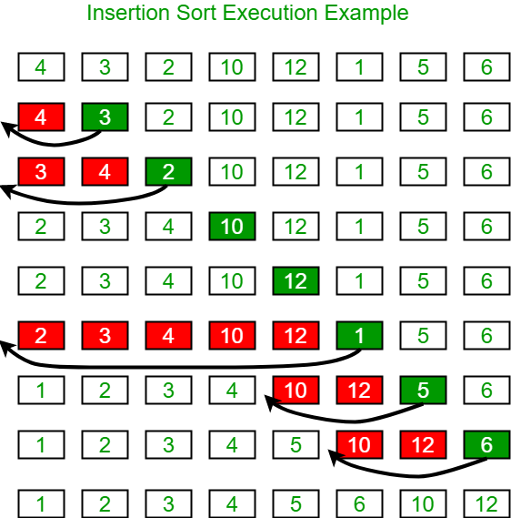
Insertion Sort

Slide 5
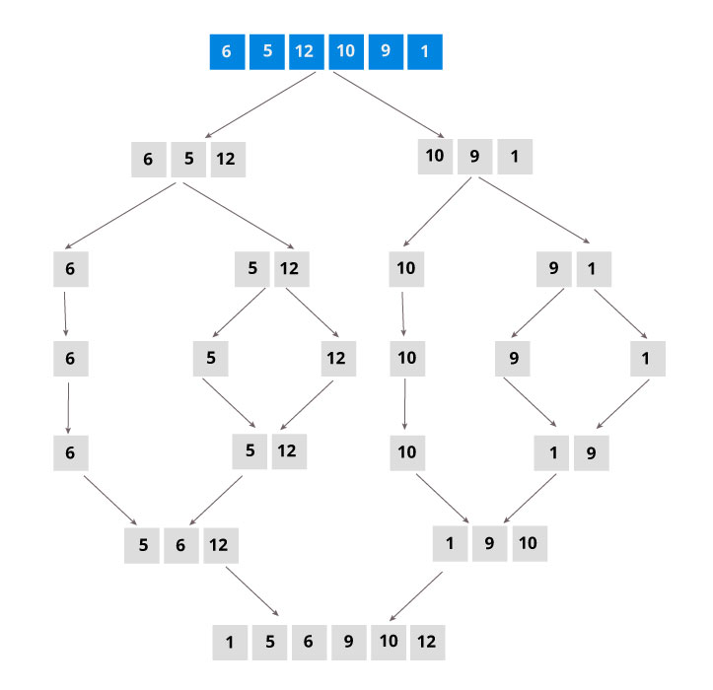
Merge Sort

Slide 6

Today’s learning:
Sorting Algorithm
Insertion Sort
Merge Sort
Thank You!

